Slide 1
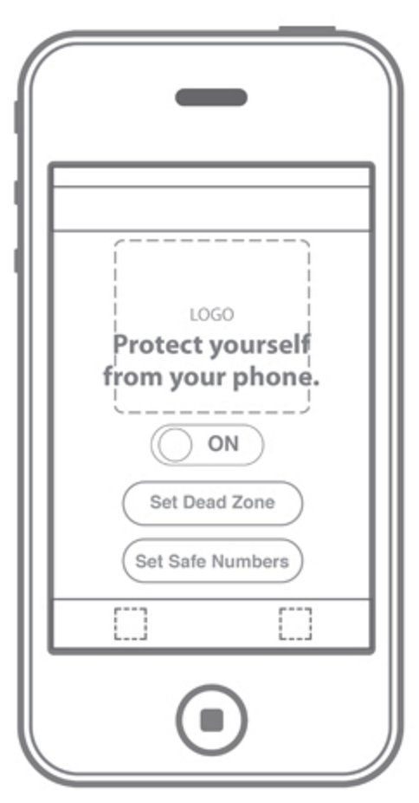
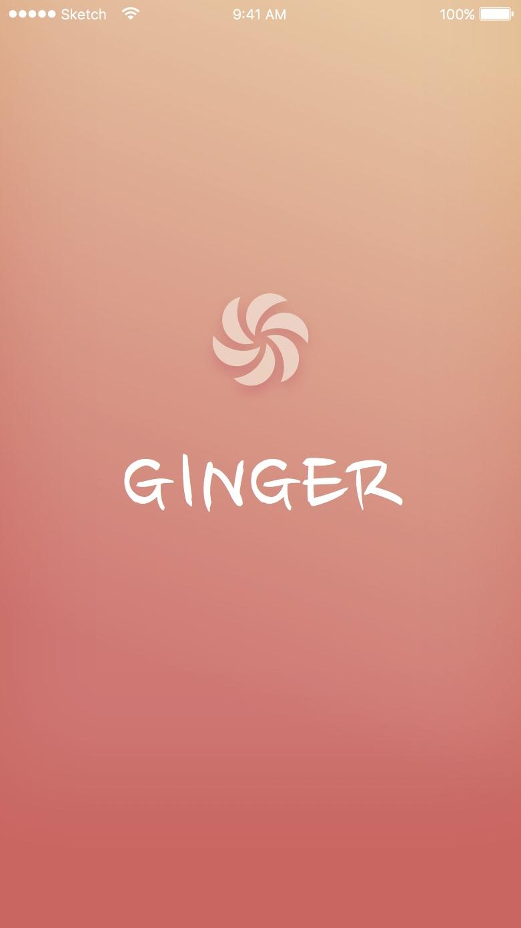

Discover local goods

Slide 2
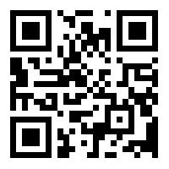
How do you buy a pair of shoes?
PROBLEM
Try Ginger

Slide 3
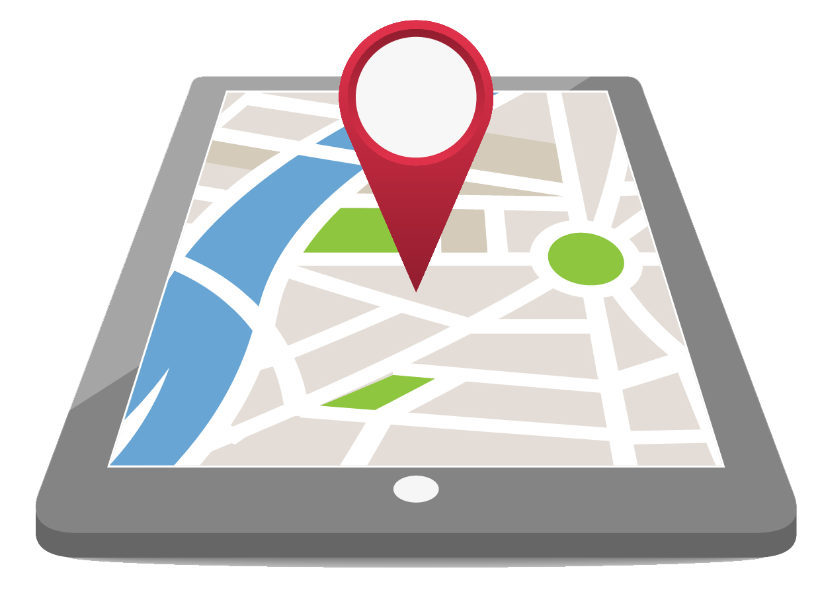
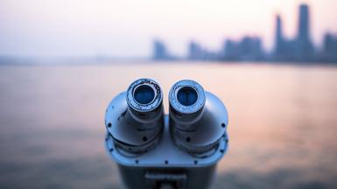

Values of Ginger
Local
Discovery
Communication

Slide 4
How does a free app make money?
Business
Model

Slide 5

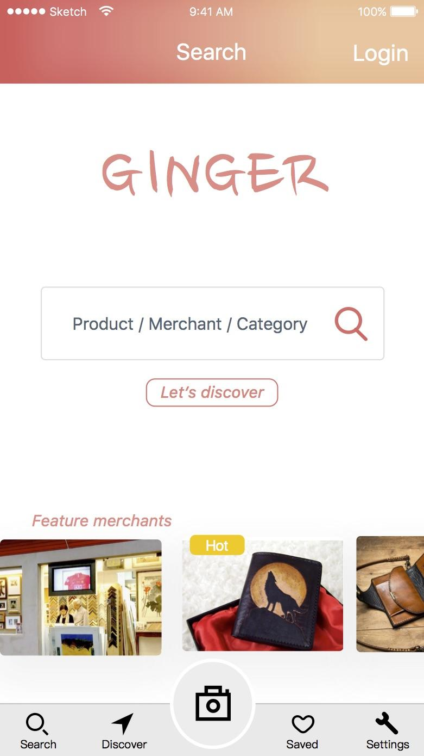
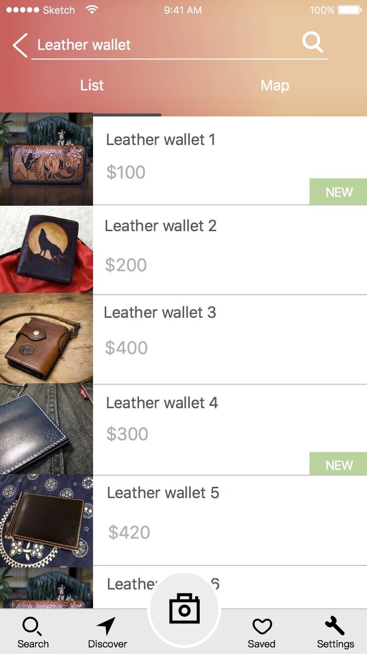

Ad spaces - 20

Slide 6
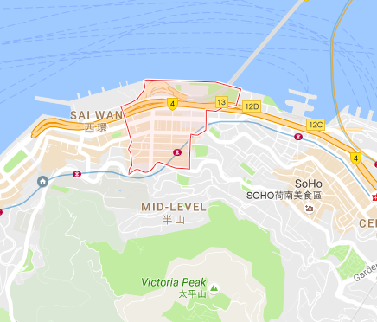
Ad
Quadrants radius -- 500m
Area of Hong Kong -- 1100 sq. km
Total Quadrants --1400

Slide 7

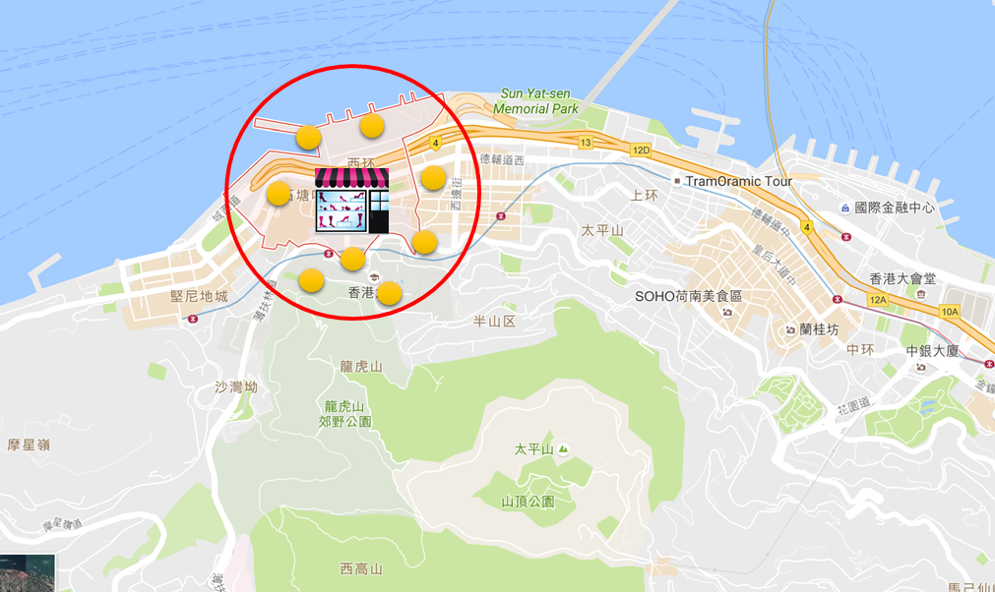
Shop inside qudrant

Slide 8
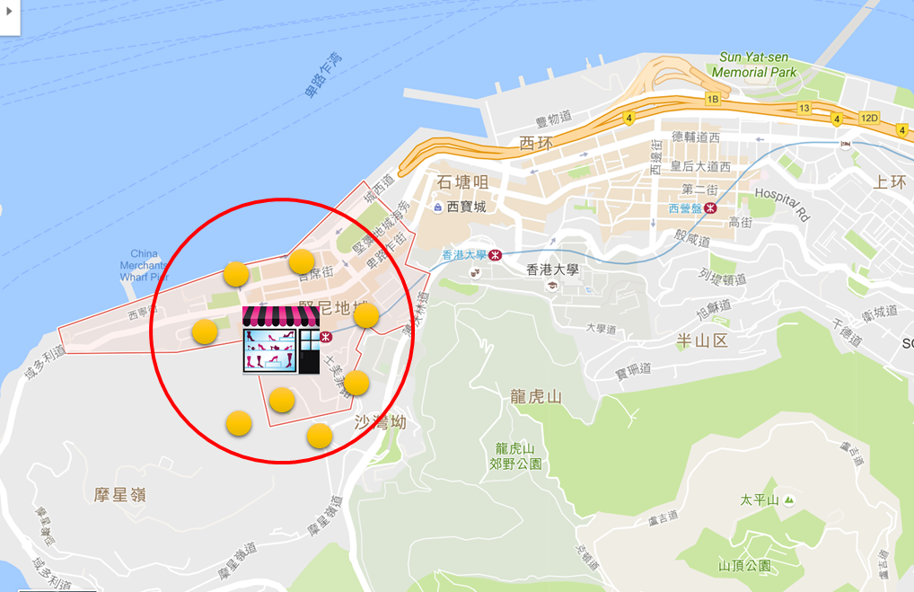
Customer base inside quadrant

Slide 9
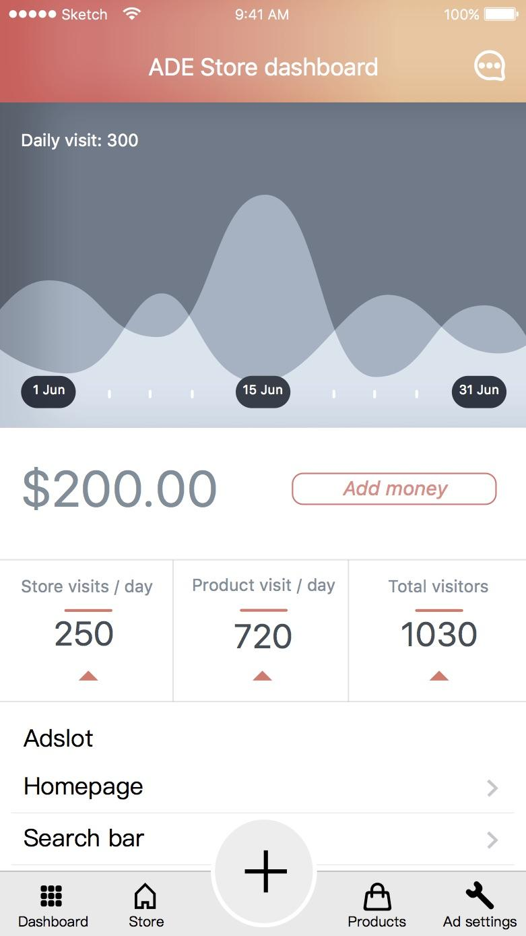

Radius and minimum bidding
500m- The merchants quadrant
Minimum Bid- $1
1 km- 4 quadrants
Minimum Bid- $5
2 km- 16 quadrants
Minimum Bid- $12

Slide 10
Estimates
With minimum bidding on half the spaces
With average bidding of $5 on half the spaces
$500,000 p.a
$25 Million p.a
28000 ad spaces
Minimum bid $1

Slide 11
Launch Strategy
Start with a small locality
Sai Ying Pun
Partner with Merchants
Cobrand
Campaign
Guerilla Marketing for users

Slide 12



Indirect Competition
Yelp
Price.com.hk

Slide 13
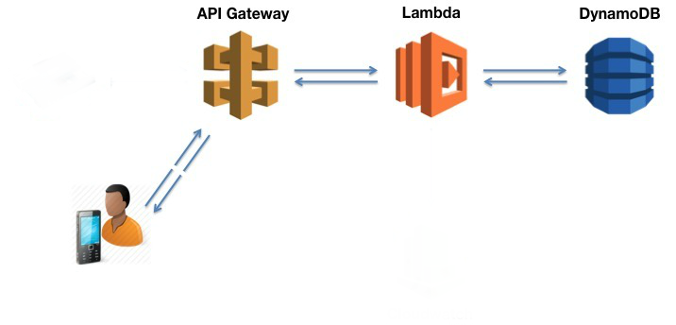
Ginger Architecture

Slide 14


THANK YOU
Questions?

